Slide 1
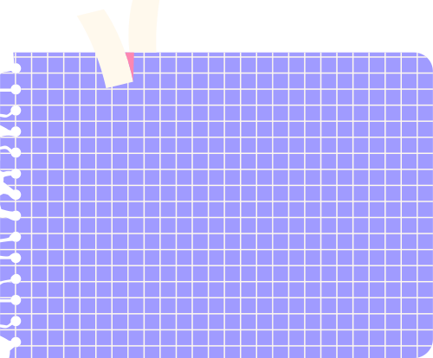





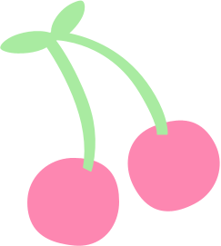



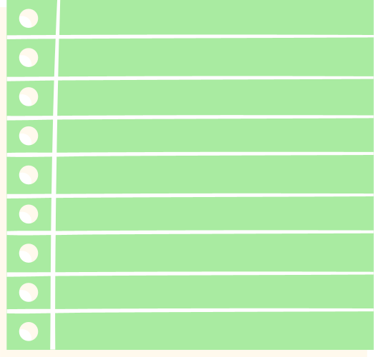
TURTLE FEATURES

Slide 2








WHAT IS TURTLE?
“Turtle” is a Python feature like a drawing board, which lets us use a pen/turtle to draw all over it!
We can use Functions in Turtle to move the turtle around.
Let’s have a look at the functions available in Turtle:
To know more about Functions, kindly refer to PPT-5 on Variables and Assignments.

Slide 3





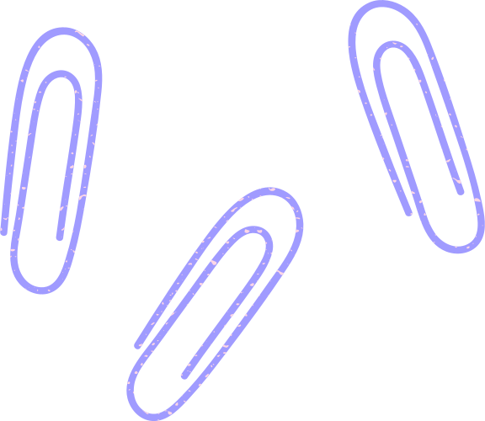
ENABLE Turtle
To work with Turtle, it is necessary to enable scripting mode for Turtle in Python IDLE. To do so, kindly follow the instructions as given in PPT T1-Turtle Graphics.

Slide 4
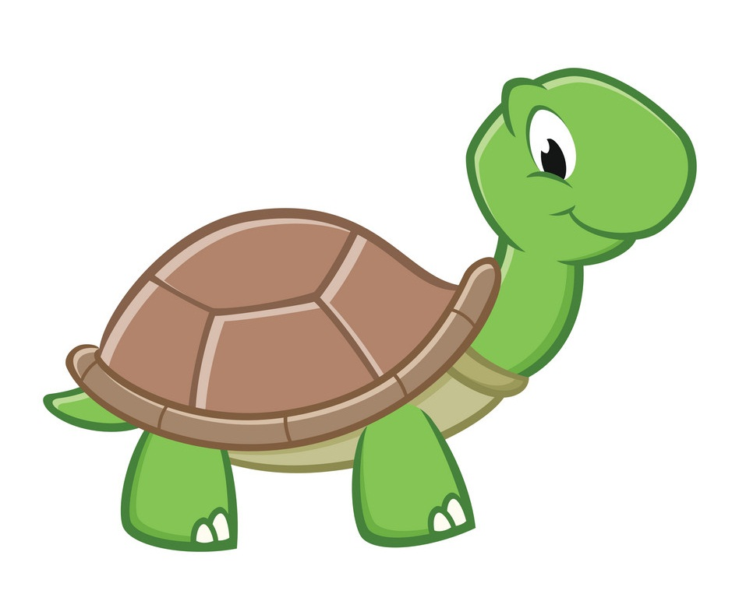
Turtle FEATURES
Turtle provides the following functions to draw, paint and create graphics designs:

Slide 5
TELL THE IDLE
YOU WANT TO USE TURTLE
It is mandatory to inform IDLE that you are using Turtle to get all the functionalities given in Turtle. You can type the following command to do so:
from turtle import *

Slide 6

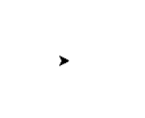
CREATE YOUR
OWN TURTLE
Turtle() function/command creates a new turtle which can be given a name:
my_turtle = Turtle()
This will open the Python Turtle Graphics window with your turtle at the centre.

Slide 7
Name your TURTLE
It is mandatory to name your Turtle according to Variable Naming Rules.
Kindly refer to PPT-6 on Keywords and Identifiers.

Slide 8
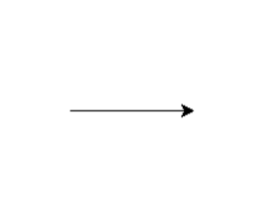
MOVE YOUR TURTLE
forward() function/command moves the turtle forward by the specified amount:
my_turtle.forward(100)
This command will move your turtle 100 pixels in the direction it is pointing to.

Slide 9
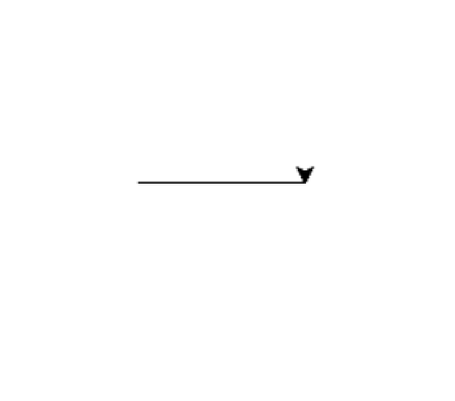
TURN YOUR TURTLE
right() function turns the turtle clockwise by the specified angle:
my_turtle. right(90)
This command will turn the direction of your turtle to the right by the angle specified within the parentheses/ round brackets.

Slide 10
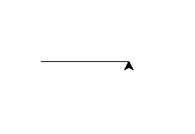
TURN YOUR TURTLE
left() function turns the turtle counter clockwise by the specified angle:
my_turtle. left(90)
This command will turn the direction of your turtle to the left by the angle specified within the parentheses/ round brackets.

Slide 11
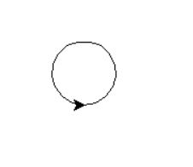
DRAW A CIRCLE
circle() function draws a circle with the specified radius (in pixels):
my_turtle. circle(30)
This command will draw a circle in the direction the turtle is pointing to with the radius specified within the parentheses/ round brackets.

Slide 12

CHANGE THE SHAPE OF
YOUR TURTLE
shape() function changes the shape of your turtle depending upon what you specify inside the parentheses/ round brackets:
my_turtle. shape(“turtle”)
Here, the value you have specified inside the parentheses/ round brackets is called ARGUMENT.

Slide 13
CHANGE THE SHAPE OF YOUR TURTLE
We can type or pass information inside the round brackets of a function.
Whatever we type inside the parentheses/ round brackets is called the ARGUMENT of the function.
EXAMPLE
my_turtle. shape(“turtle”)
Here, shape() is the function and “turtle” is the argument.
To know more about Functions, kindly refer to PPT-5 on Variables and Assignments.

Slide 14



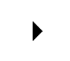
CHANGE THE SHAPE
OF YOUR TURTLE
Default: “classic”
“circle”
“square”
“triangle”
“arrow”
Other shapes include:
my_turtle. shape(“classic”)
my_turtle. shape(“circle”)
my_turtle. shape(“square”)
my_turtle. shape(“triangle”)
my_turtle. shape(“arrow”)

Slide 15
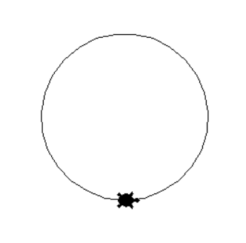
CHANGE THE SPEED OF
YOUR TURTLE
We all know that turtle is one of the slowest animals on earth. But that is not the case with Python Turtle.
You can increase/decrease the speed of your turtle using the speed() function.
speed() function changes the speed of your turtle depending upon the argument.
my_turtle. speed(5)

Slide 16
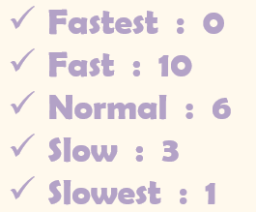
CHANGE THE SPEED OF
YOUR TURTLE
We can give any value in the range 0-10 as argument for the speed() function.
If an argument does not lie in the given range, the speed is set to 0 (fastest).
The speed increases from 1 to 10.
0 is the fastest speed.

Slide 17
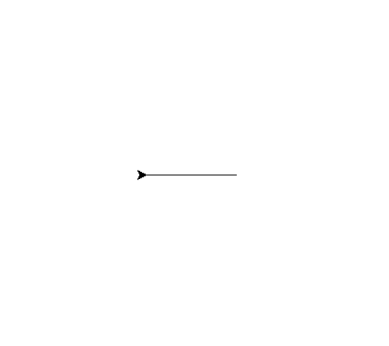
MOVE YOUR TURTLE
backward() function/command moves the turtle backward by the specified amount:
my_turtle.backward(100)
This command will move your turtle 100 pixels in the opposite direction it is pointing to.

Slide 18


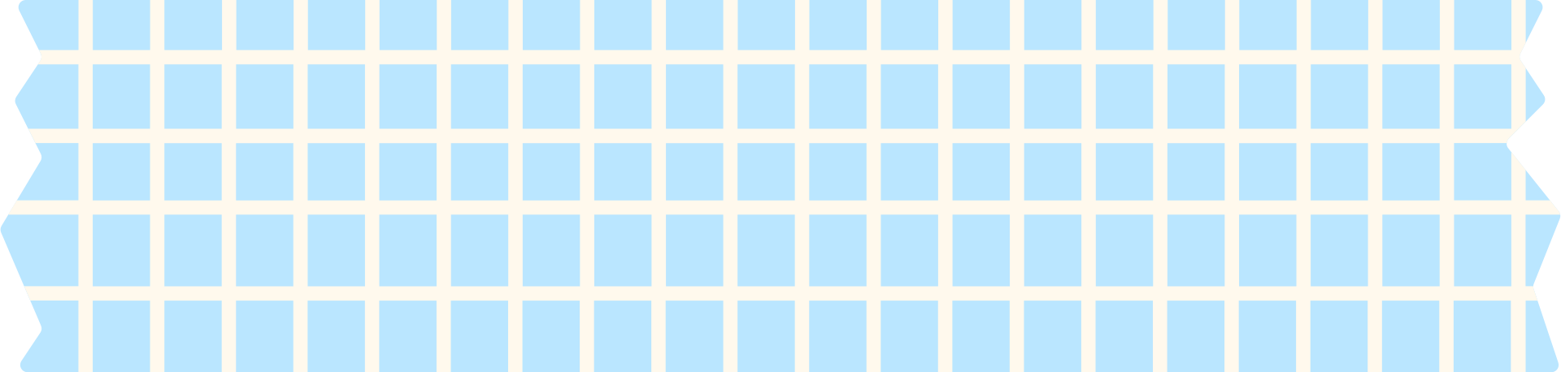





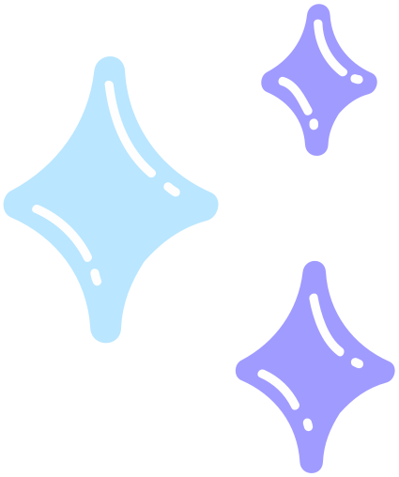



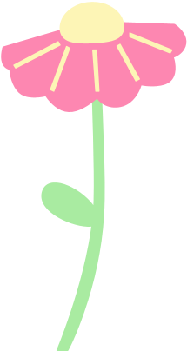


LET’S ADD SOME COLORS!!!

Slide 19
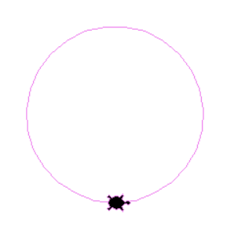
CHANGE YOUR INK COLOR
pencolor() function is used to change the color of the ink of the turtle drawing.
The default color is black.
my_turtle.pencolor(“violet”)

Slide 20
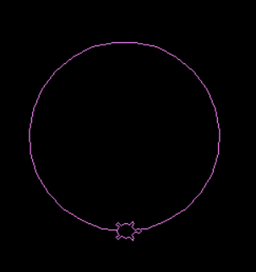
CHANGE YOUR
BACKGROUND COLOR
bgcolor() function is used to change the color of the background of the turtle drawing.
The default color is white.
bgcolor(“black”)

Slide 21
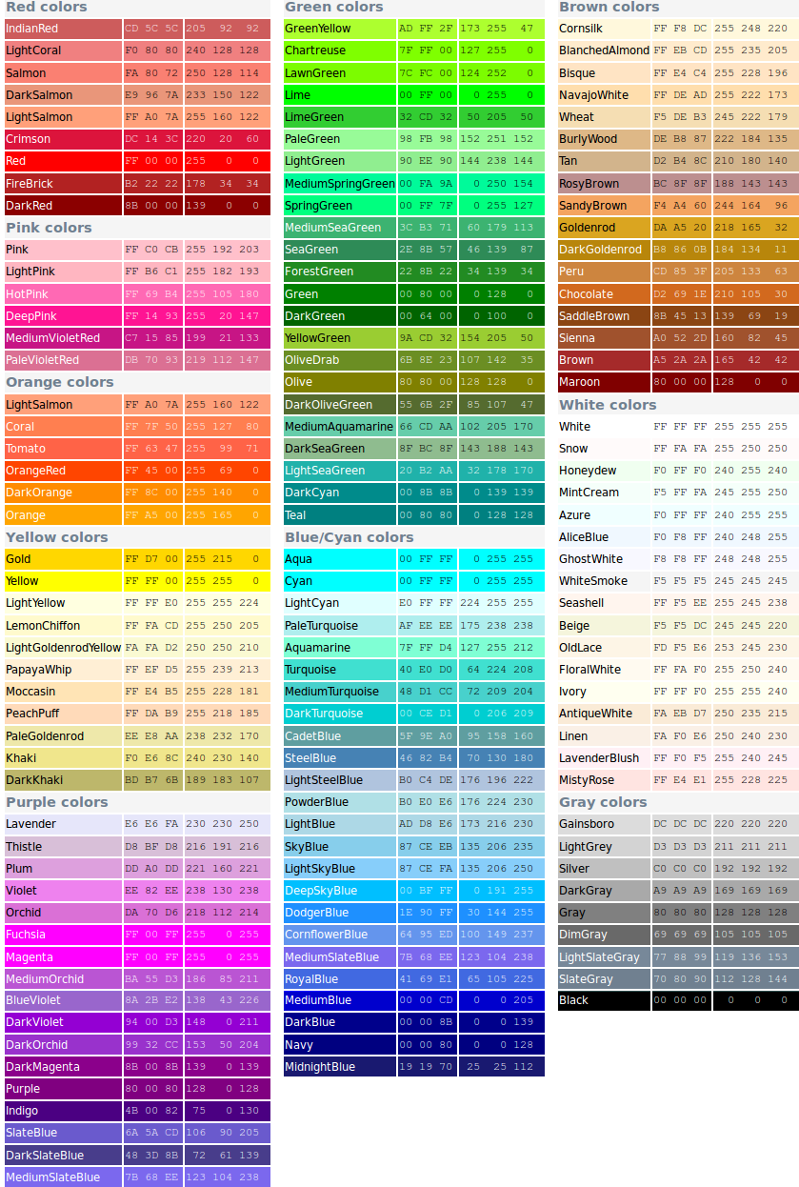
AVAILABLE COLORS in turtle
Use these colors as strings (text enclosed within double quotes) as arguments for pencolor()/ bgcolor().

Slide 22
AVAILABLE COLORS in turtle

Slide 23

FILL COLOR
begin_fill() and end_fill() functions are used to fill a closed shape in your turtle drawing.
The code to draw the closed shape must be written between the two functions.
my_turtle.color("violet")
my_turtle.begin_fill()
my_turtle.circle(90) #Closed Shape
my_turtle.end_fill()

Slide 24
FILL COLOR
When we use these two functions- begin_fill() and end_fill(), we have to specify which color we want to use.
color() function allows us to choose the color of our choice.
All the letters in color must be in lowercase (small letters).
The colors must be enclosed within double quotes (given as strings).

Slide 25
FILL COLOR
color() function can take one/two arguments.
If it takes one argument, then it is used as pencolor and the same color will be filled within the shape.
my_turtle.color("violet") #For Outline and Filling
my_turtle.begin_fill()
my_turtle.circle(90) #Closed Shape
my_turtle.end_fill()

Slide 26
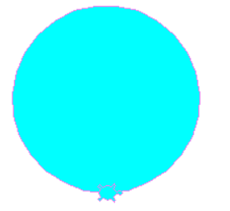
FILL COLOR
color() function can take one/two arguments.
If it takes two arguments, then the first argument is used as outline color and the second argument is used for filling the shape.
my_turtle.color("violet" , "cyan") #(Outline, Filling)
my_turtle.begin_fill()
my_turtle.circle(90) #Closed Shape
my_turtle.end_fill()

Slide 27
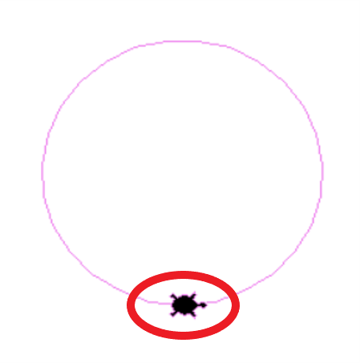
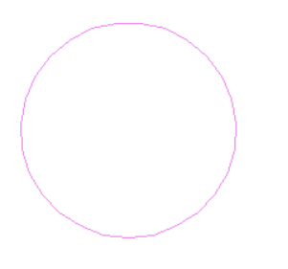
Hide and seek
If you don’t want your turtle on the screen after the completion of your drawing or if you don’t want to see your turtle moving while it draws, you can choose to hide your turtle. hideturtle() function can be used to camouflage your turtle so that it is not visible on the screen.
my_turtle.hideturtle()

Slide 28
Hide and seek
There are two ways to hide your turtle:
You can hide it after the completion of your drawing, so that you can see only what you have drawn.
You can hide it if you don’t want to see your turtle moving while it draws.
If you want to see your turtle moving while it draws and hide it later, you have to use the hideturtle() function at the end of your code.
But, if you don’t want to see your turtle at all while drawing, you can use the hideturtle() function as soon as you create and name your turtle (at the beginning).

Slide 29
Hide and seek
You can use the showturtle() function to bring your turtle back to the screen (provided you had hidden it earlier).
my_turtle. showturtle()

Slide 30


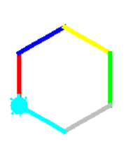
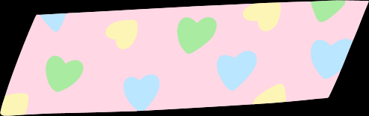
TRY THESE OUT!!

Slide 31

HAPPY LEARNING!

